Slide 1



X
Final Project
Data Engineer
Presented by
Yanyan Gatot Mulyadi

Slide 2


Yanyan Gatot Mulyadi
Experience
Marketing
Pisang Tanduk 33
10 October, 2020 - Present
About You
Maketing
As a business graduate with a keen interest in data analysis, I possess a strong foundation in market research and SQL. I am adept at leveraging data to uncover valuable insights and develop impactful marketing campaigns. With a curious and innovative mindset, I constantly explore new ways to harness the power of data to drive business performance. My expertise in SQL allows me to efficiently manage and analyze large datasets, enabling data-driven decision-making. I am passionate about staying abreast of industry trends and leveraging data to achieve marketing success and deliver tangible results.
Coolbeans Production
05 Juni, 2017 - 20 July, 2020

Slide 3
Case Study
One of ID/X Partners' clients, operating in the e-commerce industry, has a need to create a Data Warehouse sourced from several tables in the source database. This Data Warehouse will consist of one Fact table and several Dimension tables.

Slide 4
Task
1. Perform Import/Restore of Staging Database.
2. Create a Database named DWH_Project, and create Fact and Dimension Tables from the tables in the Staging Database.
3. Build an ETL Job in Talend application to transfer data from Staging to Data Warehouse. Specifically, for the DimCustomer Table, perform data transformation by converting data in FirstName and LastName columns to all capital letters, then combine these two columns into a single column named CustomerName.
4. Develop a Stored Procedure (SP) to display a summary of sales orders based on the delivery status.

Slide 5
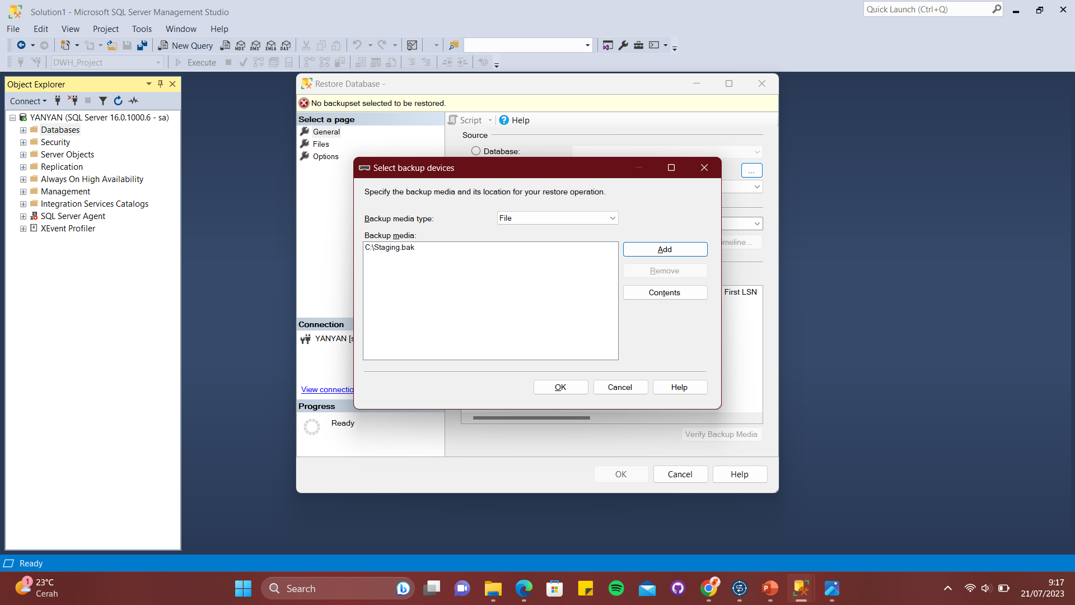
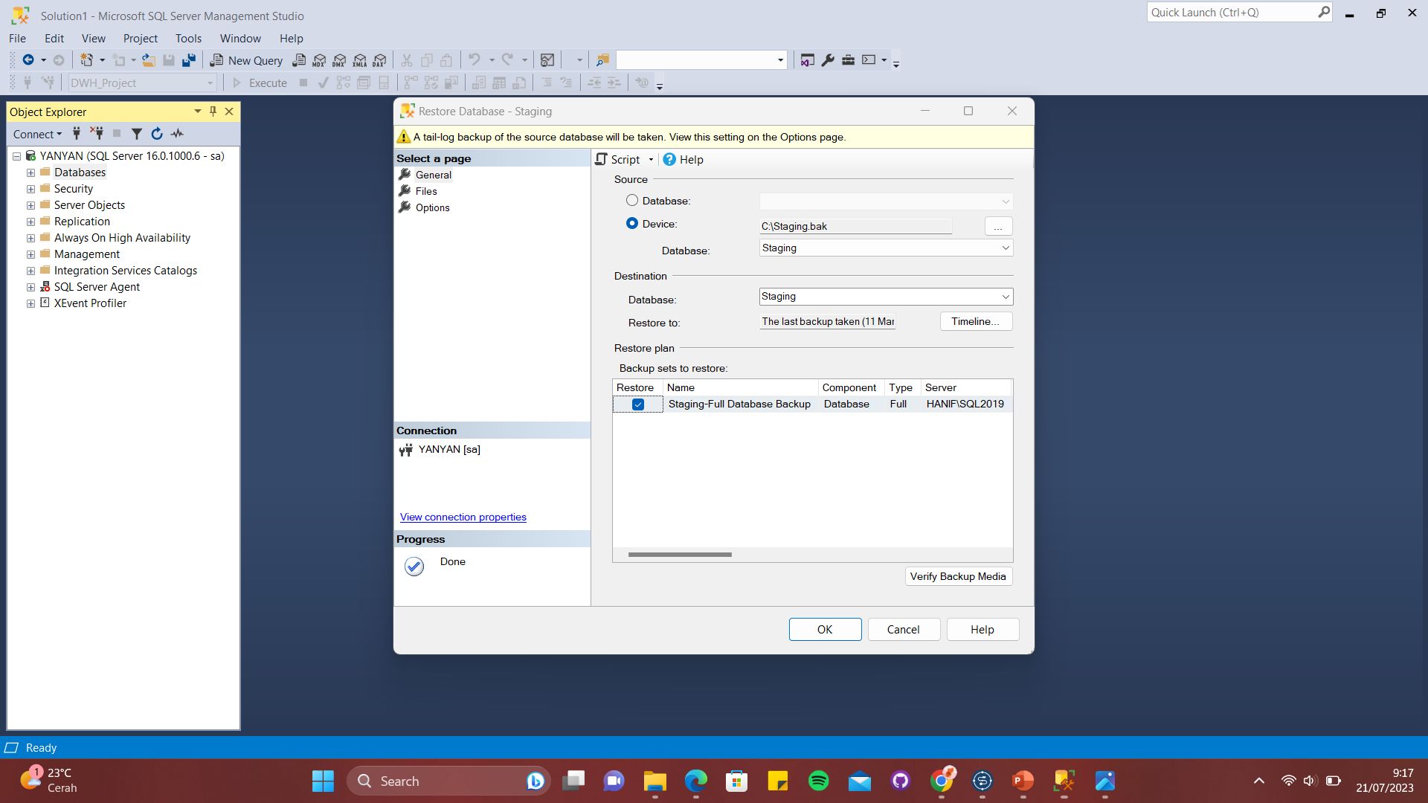
Result
1. Restore Database Staging

Slide 6
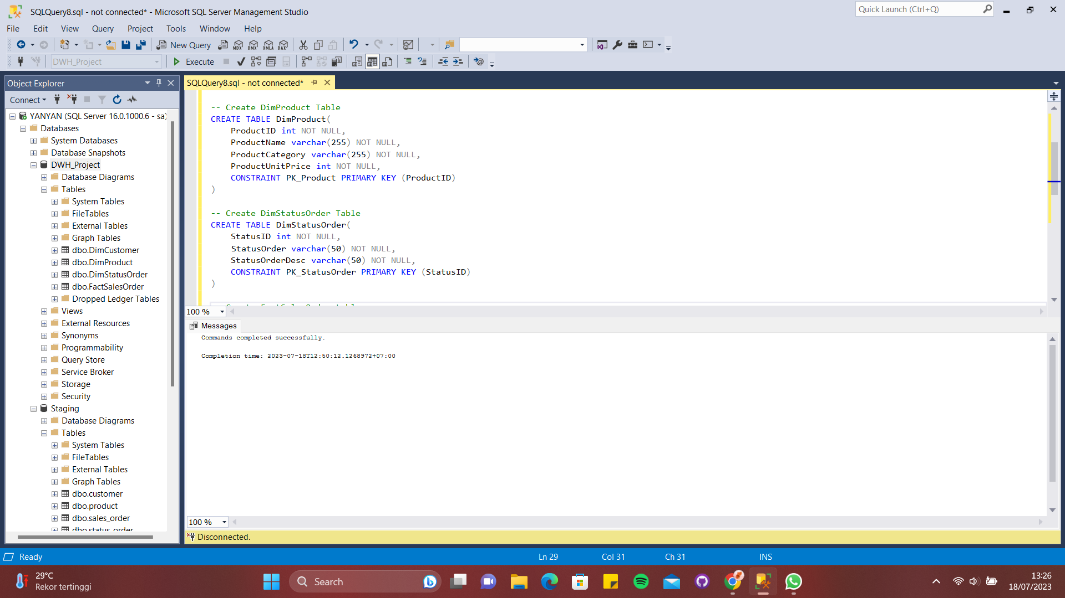
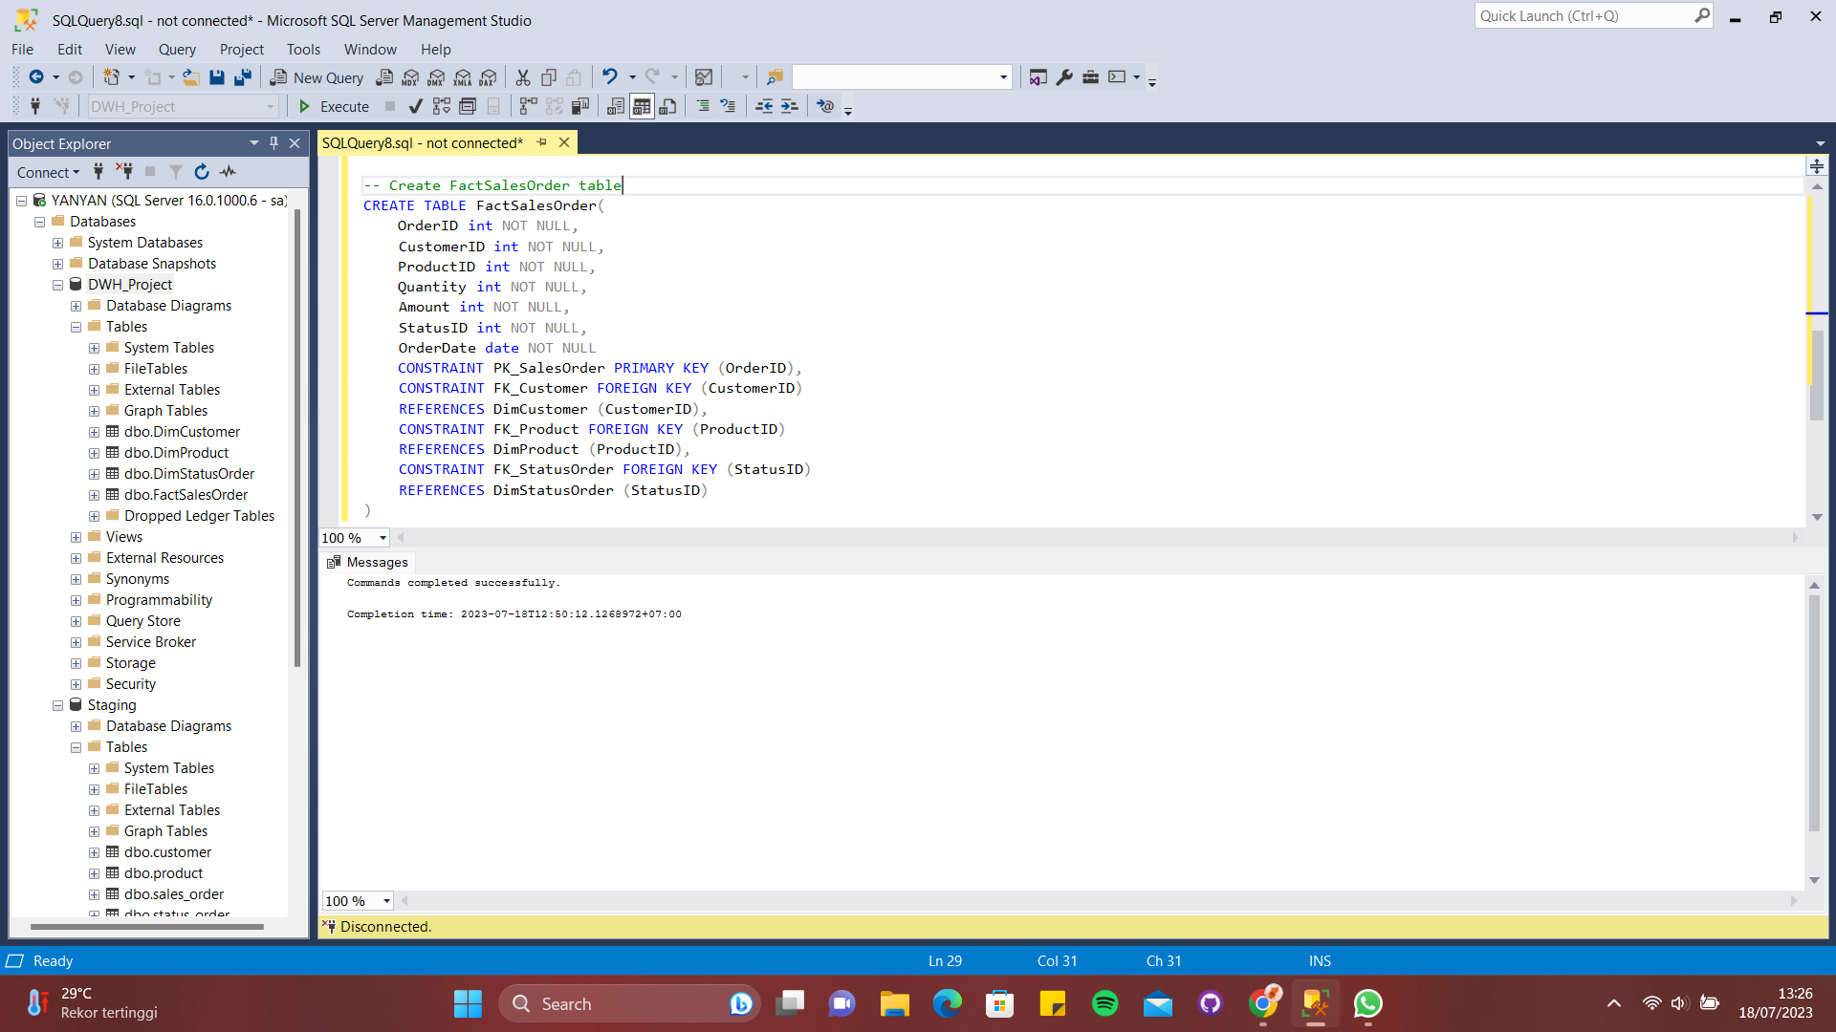
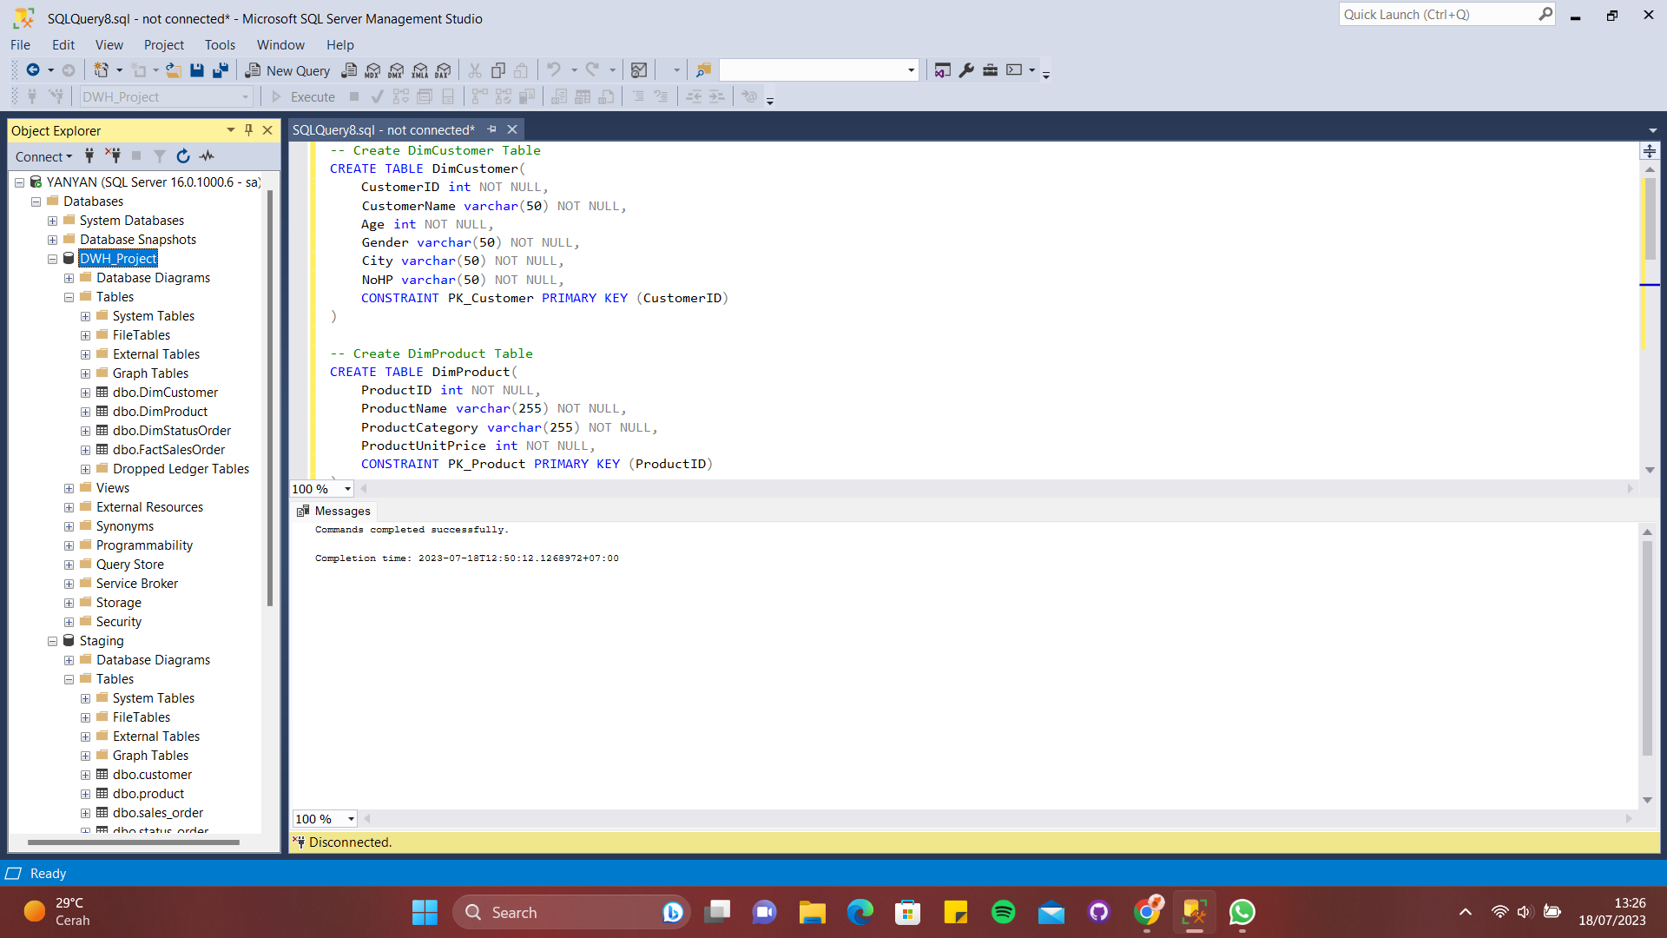
2. Create a Database named DWH_Project, and create Fact and Dimension Tables from the tables in the Staging Database.

Slide 7
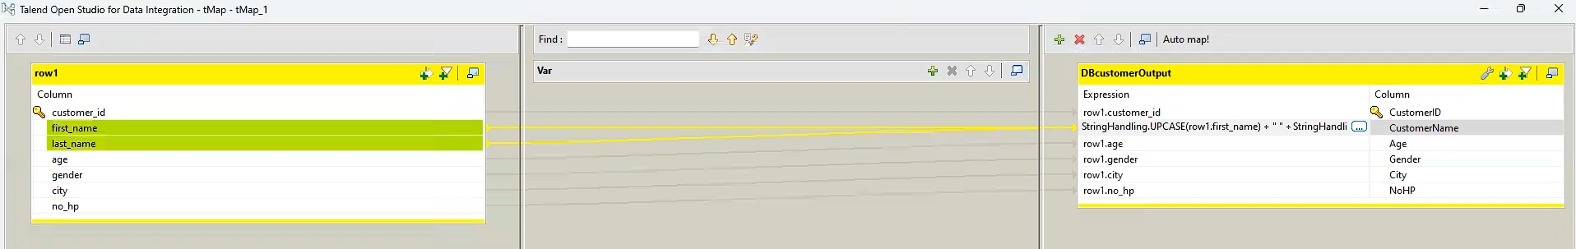
3. Build an ETL Job in Talend application to transfer data from Staging to Data Warehouse. Specifically, for the DimCustomer Table, perform data transformation by converting data in FirstName and LastName columns to all capital letters, then combine these two columns into a single column named CustomerName.

Slide 8
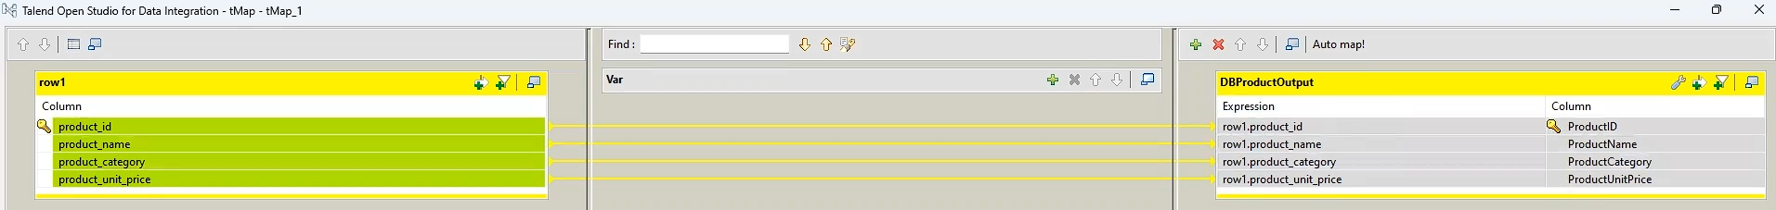
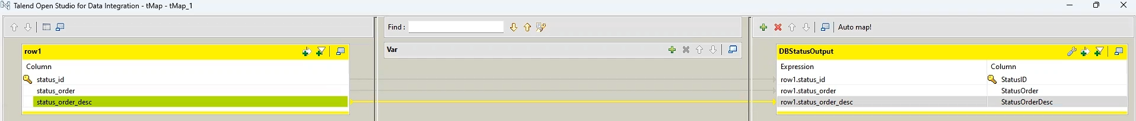
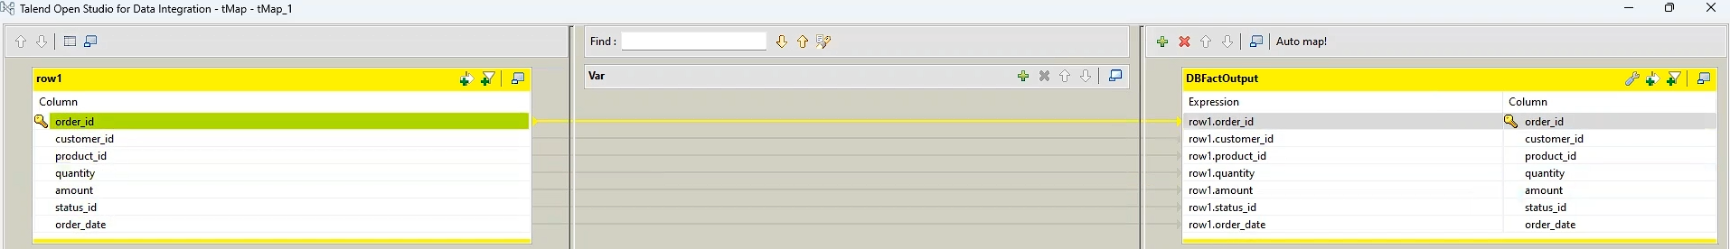

Slide 9
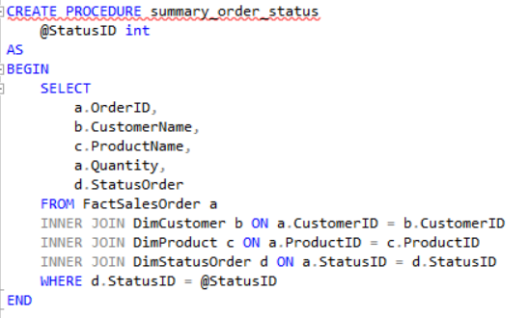
4. Develop a Stored Procedure (SP) to display a summary of sales orders based on the delivery status.

Slide 10
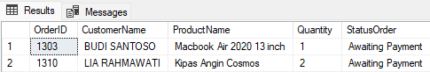
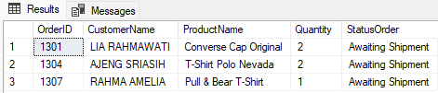
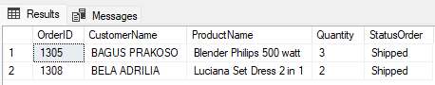
There are 2 orders with the status "Awaiting Payment" (Status ID 1).
There are 3 orders with the status “Awaiting Shipment” (Status ID 2)
There are 2 orders with the status “Shipped” (Status ID 3)

Slide 11
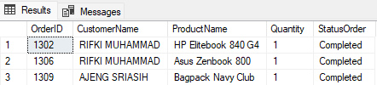
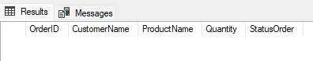
There are 3 orders with the status “Completed” (Status ID 4)
There is no order with the status “Cancelled” (Status ID 5)

Slide 12
Link Github
https://github.com/Yanyan2410/FinalTask_IDX-Partners_DE_Yanyan-Gatot-Mulyadi

Slide 13
Thank You
X

